Slide 1
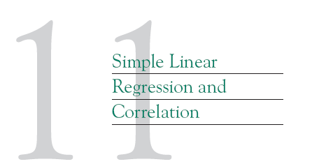

Slide 2

1. Regression methods were used to analyze the data from a study investigating the relationship between roadway surface temperature (x) and pavement deflection (y). Summary quantities were
(a) Calculate the least squares estimates of the slope and intercept. Graph the regression line. Estimate .
(b) Use the equation of the fitted line to predict what pavement deflection would be observed when the surface temperature is 85°F.
(c) What is the mean pavement deflection when the surface temperature is 90°F?
(d) What change in mean pavement deflection would be expected for a 1°F change in surface temperature?
σ²

Slide 3
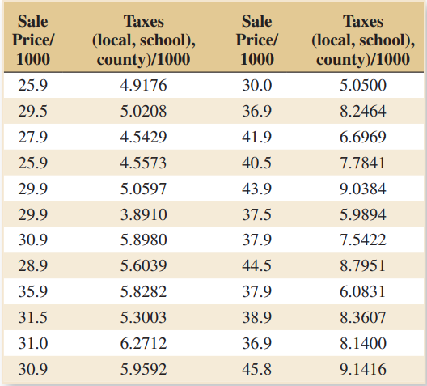
2. An article in Technometrics by S. C. Narula and J. F. Wellington [“Prediction, Linear Regression, and a Minimum Sum of Relative Errors” (1977, Vol. 19)] presents data on the selling price and annual taxes for 24 houses. The data are in the Table E11-2.
Assuming that a simple linear regression model is appropriate, obtain the least squares fit relating selling price to taxes paid. What is the estimate of ?
Find the mean selling price given that the taxes paid are x = 7.50.
Calculate the fitted value of y corresponding to x = 5.8980. Find the corresponding residual.
σ²

Slide 4


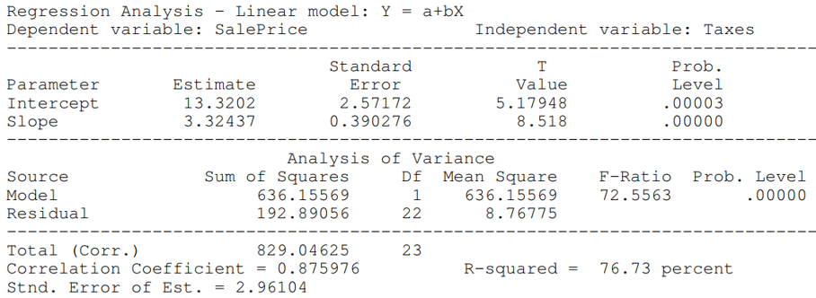
3. Consider the data from Exercise 2 on y = sales price and x = taxes paid.
(a) Test using the t-test; use α = 0.05.
(b) Test the hypothesis that

Slide 5

4. An article in Concrete Research [“Near Surface Characteristics of Concrete: Intrinsic Permeability” (1989, Vol. 41)] presented data on compressive strength x and intrinsic permeability y of various concrete
mixes and cures. Summary quantities are
Compute the sample correlation coefficient.

Slide 6
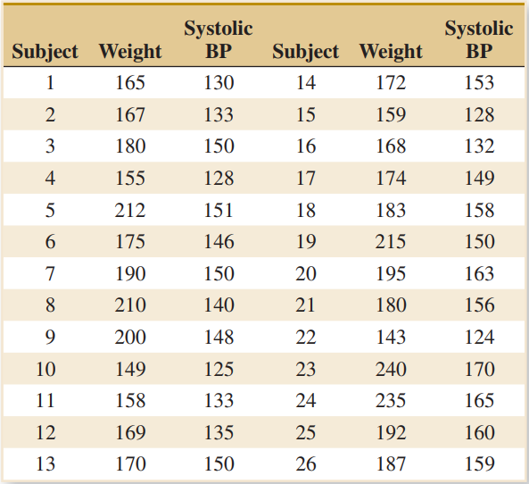
5. The weight and systolic blood pressure of 26 randomly selected males in the age group 25 to 30 are shown in this table. Assume that weight and blood pressure are jointly normally distributed.
Find a regression line relating systolic blood pressure to weight.
Estimate the correlation coefficient.
Test the hypothesis that ρ = 0, using α = 0.05.

